Slide 1


Future of SE Research:
Research for SE,
SE for Research
tim.menzies@gmail.com
https://menzies.us
October 2015
Slides: tiny.cc/se15
ai4se.net

Slide 2
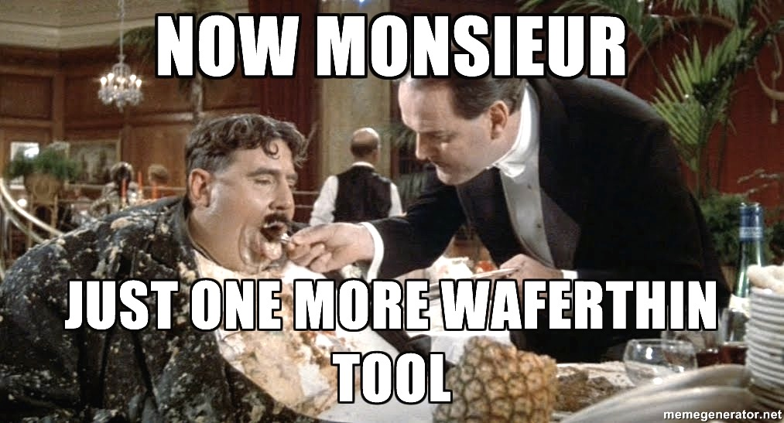
Data mining tools should, and can, do much more
Operating systems do more than just schedule processes:
Editors
Compilers
File systems,
Network connections,
Memory management
Etc
What services should be standard in data mining tools?
ai4se.net

Slide 3
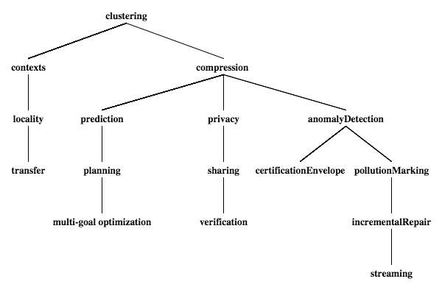
IEEE trans SE ’13b
IEEE trans SE ‘13a
Wvu ‘13
ESE ‘09 ESE ‘14
Icse ‘16?
ICSE ‘15
IEEE trans SE ‘12
IEEE trans SE ‘15

Slide 4

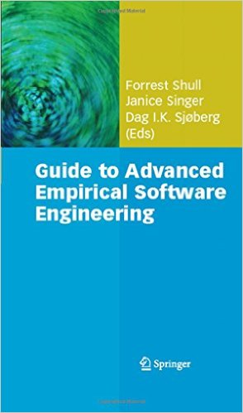
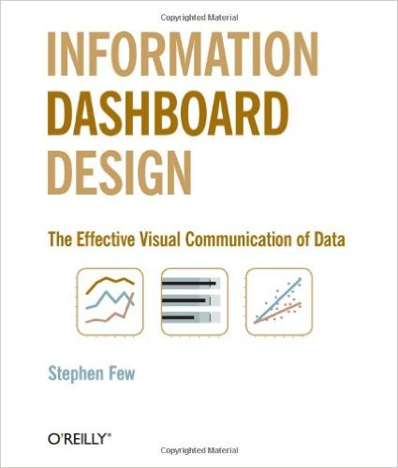
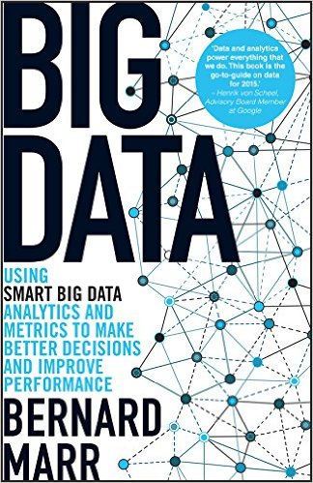
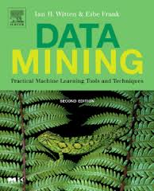
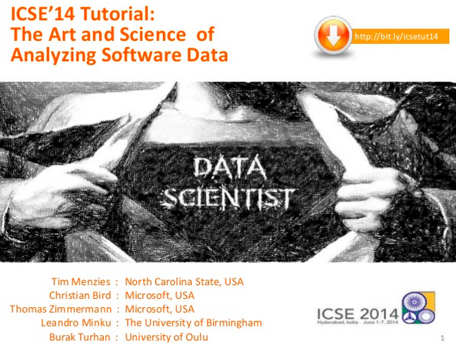
Not in this talk: not what everyone else is talking about
Principles for designing case studies
Visualizations
Data mining
Big Data
Qualitative methods see parts1+2

Slide 5

The talk… adding in some missing bits

Slide 6
Software tools for “citizen scientists”.
Beyond mere data repositories
What happens when decision software goes wrong?
Proposed services for nextgen repositories
The Future?
ai4se.net

Slide 7
Software tools for “citizen scientists”.
Beyond mere data repositories
What happens when decision software goes wrong?
Proposed services for nextgen repositories
The Future?
ai4se.net

Slide 8
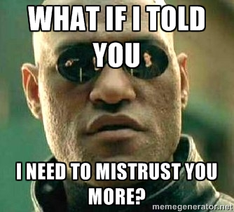
Software tools for “citizen scientists”
Science has escaped the lab
roaming free in the world.
When every citizen can be a scientist (making generalizations from data)
Then it should be possible to audit those conclusions
Want to mistrust the conclusions of citizen scientists
Just as we mistrust and evaluate, review, explore, evolve the conclusions of any other scientist.

Slide 9
Software mediates what we see and how we act in the world
Silicon valley developers view every new feature as an experiment, to be tested within some mash up.
Chemists win Nobel Prize for software sims http://goo.gl/Lwensc
Engineers use software to optical tweezers, radiation therapy, remote sensing, chip design, http://goo.gl/qBMyIZ
Web analysts use software to analyze clickstreams to improve sales and marketing strategies; http://goo.gl/b26CfY
Stock traders write software to simulate trading strategies http://www.quantopian.com
Analysts write software to mine labor statistics data to review proposed gov policies http://goo.gl/X4kgnc
Journalists use software to analyze economic data, make visualizations of their news stories http://fivethirtyeight.com
In London or New York, ambulances wait for your call at a location determined by a software model http://goo.gl/8SMd1p
Etc etc etc

Slide 10
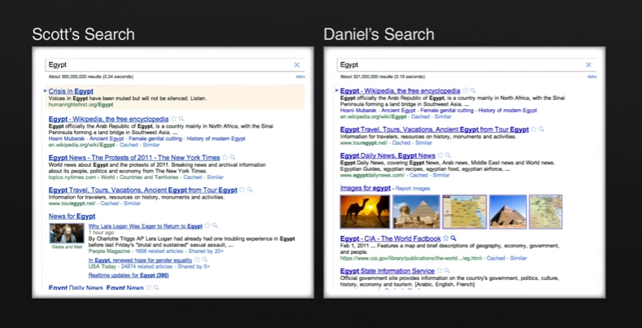
Important to understand how software can divides us
See also “Facebook emotion study breached ethical guidelines, researchers say” June 30, 2014, The Guardian http://goo.gl/gTRkmp

Slide 11
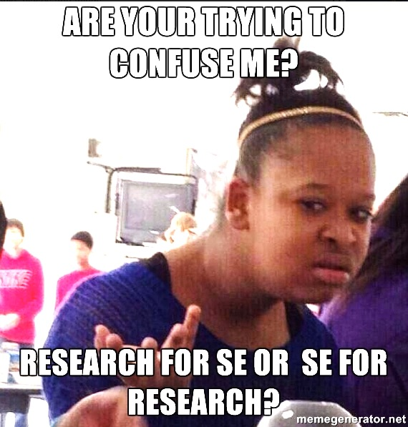
Yes.
ai4se.net

Slide 12
Better SE = better data science = better science
Data scientist isa software engineering
A data scientist isa engineer
Delivering, under constraints, to acceptable quality standards
A data scientist isa software developer
Complex scripts, test-driven development, version control
A data scientist isa requirements engineering
Understanding and navigating and trading off between user goals
A data scientist isa agile programmer
Uses feedback from writing, running code and query results to constantly revise goals and code

Slide 13
Software tools for “citizen scientists”.
Beyond mere data repositories
What happens when decision software goes wrong?
Proposed services for nextgen repositories
The Future?
ai4se.net

Slide 14
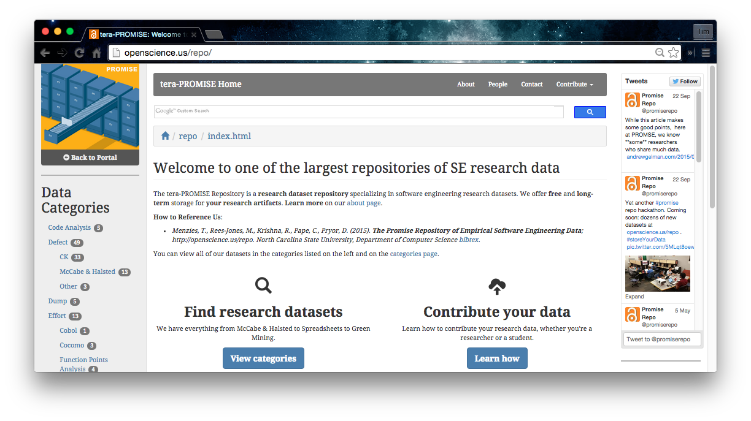
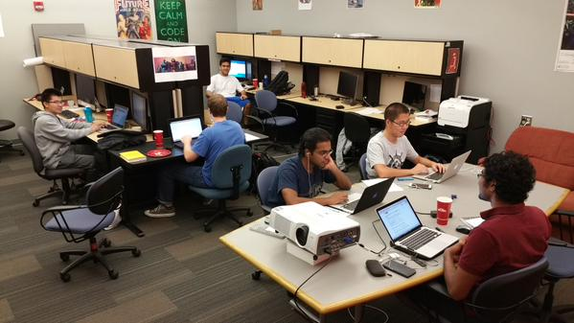

http://openscience.us/repo
#storeYourData
URL openscience.us/repo
Data from 100s of projects
E.g. EUSE: 250,000K+ spreadsheets
E.g. Softgoals: 150+ softgoal models
Oldest continuous repository of SE data (2004)

Slide 15
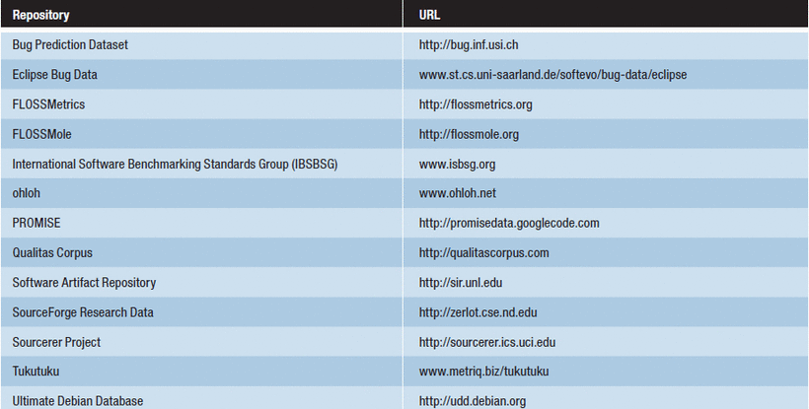
So many data repositories
What’s next?
What tools would we need for an “debate”-oriented repository ?

Slide 16
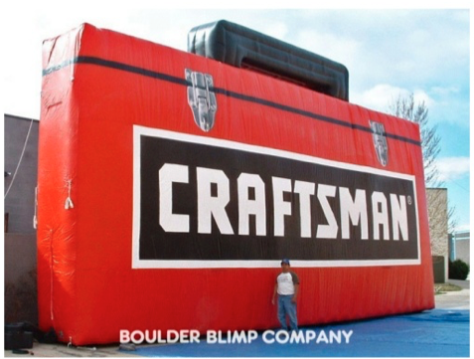
Let’s talk tools
To design those tools, ask:
What problems are seen when people try to share data and conclusions?
What minimal data structures address those problems?
ai4se.net

Slide 17
Software tools for “citizen scientists”.
Beyond mere data repositories
What happens when decision software goes wrong?
Proposed services for nextgen repositories
The Future?
ai4se.net

Slide 18
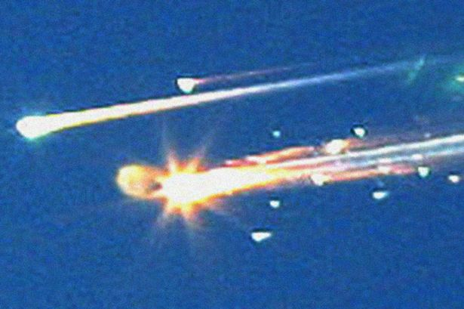
Models have “certification envelopes”
Bad things happen when you stretch the envelope
Columbia ice strike
Size: 1200 m²
Speed: 477 mpg (relative to vehicle)
Certified as “safe” by the CRATER micro-meteorite model.
A experiment in CRATER’s DB:
Size: 3cm³
Speed: under 100 mpg
Columbia, and crew, dies on re-entry
Lesson: conclusions should come with a “certification envelope”
If new tests outside of the envelope of the training set
Raise an alert

Slide 19
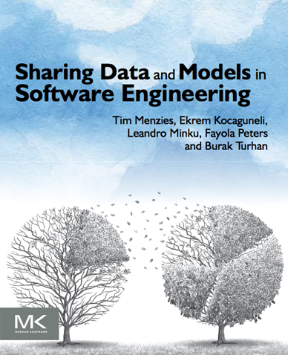
Goals matter
Learners learn for X, users want Y
Learners work this way
Users want it that way
Waste of time learning models users do not want
Better to tune learning methods to goals of users
Enter search-based software engineering
Multi-goal optimization

Slide 20
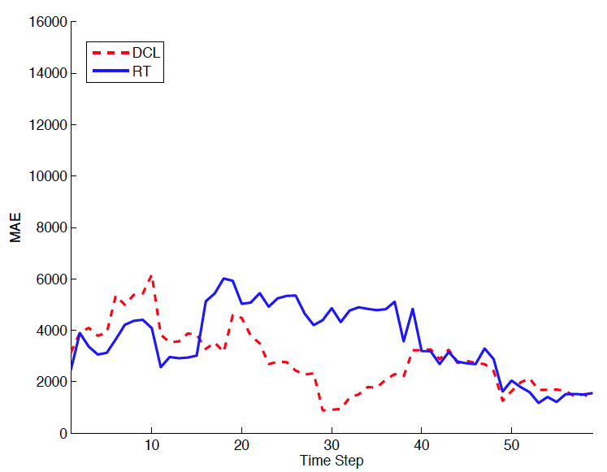
Locality matters (what is true there may not be true here)
Not general models ,but general methods for local models
Devanbu et al. ASE’11 Ecological Inference
Betternburg et al. MSR’12 Think local, act global,
Menzies et al. TSE’13 Local versus Global learning,
Yang et al. IST’13 Handling local bias,
Minku et al. ICSE’14 Best Use of Cross-Company Data
Using ensemble data
Using local data
Error (less is better)

Slide 21

Sharing matters
Given enough eyes, all bugs are shallow
When (2013) | What
Mar 15 | “Better cross-company learning” accepted to MSR’13
Mar 29 | Camera-ready submitted
?Apr 10 | Pre-prints go on-line
Apr 29 | Hyeongmin Jeon, graduate student at Pusan Natl. Univ.emailed us: can’t reproduce result
May 4 | Fayola Peters, checking code, found error. Manic week of experiments follow
May 11 | We conclude results definitely wrong
May 12 | Email MSR organizers. Our penalty? Present paper and its error.
How was the error found so fast?
Open science

Slide 22
Compression and privacy matter
Squeezing and secrets
Facebook, Google, Netflix etc
Small X% of all users are subjects in continual experiments: testing new features
Data from studies, retained indefinitely, warehoused
Problems with volume (needs compression)
Problems with confidentiality (needs privacy)
If I want to challenge the conclusions made by Facebook, Google, Netflix, etc
I need to be able to access, privately, that data
(needs trusted sharing)

Slide 23
Lessons learned
What matters?
Certification envelopes (when not to trust conclusions)
Goals matter (not everything is “classification”)
Locality matters (when their conclusions do not hold for you)
Need “streaming tools” (continually stream over a never ending sequence of new data)
Need repair tools (to fix broken ideas)
Verification matters (sooner or later, we all screw up)
Need to transfer data (get by with a little help from your friends)
Need compression tools (to save space)
Need privacy tools (so you can share)

Slide 24
Software tools for “citizen scientists”.
Beyond mere data repositories
What happens when decision software goes wrong?
Proposed services for nextgen repositories
The Future?
ai4se.net

Slide 25
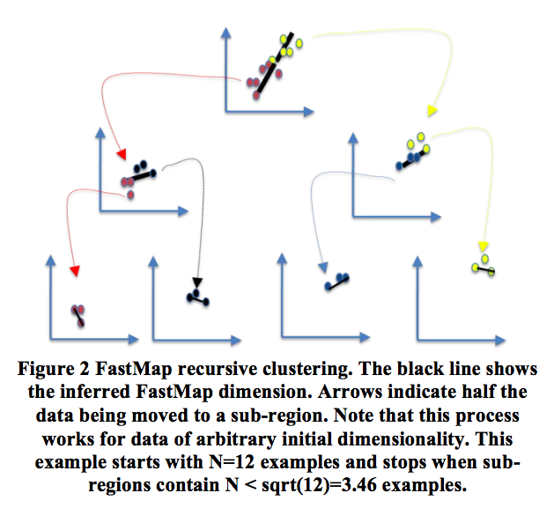
Digression: WHERE: O(N)top-down divisive clusterings
Fast: works on an approximation to eigenvectors (the FASTMAP heuristic) Faloutsos [1995]. A O(N) generation of axis of large variability
Pick any point X;
Find E= East = furthest from X,
Find W = West furthest from East.
East, West = “the poles”
All points have distance a,b to (E,W)
c = dist(W,E)
x = (a² + c² − b²)/2c
Find median(x), recurse on each half

Slide 26
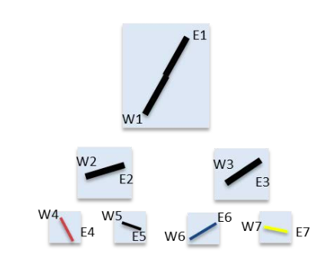
WHERE approximates data as multiple linear models (drawn in eigenspace)
If
Platt 2005: FASTMP= Nystrom algorithm = approximations to PCA.
combines similar influences, ignores irrelevancies, outliers

Slide 27
Hold that thought
Underlying data structure
to much of my current thinking
If
If cluster to leaves of size sqrt(n),
Only need 2*sqrt(n)-1 nodes, each with 2 poles
So 4*sqrt(n) – 2 examples
Which we can reduce, later (see optimization)

Slide 28
Is Where a multi-objective optimization algorithm? Mutate towards useful “end”? Now can reason about combinations of user goals?
Evolutionary optimizers = select, crossover, mutate, repeat
Select:
Evaluate each pole as you descend the tree
Cull the half leading to the worst pole
Crossover, mutate
In the surviving leaves,
mutate examples towards to the best pole
Krall (WVU), Menzies et al. TSE 2015, GALE. Orders of magnitude faster than standard optimizers. Just as effective

Slide 29
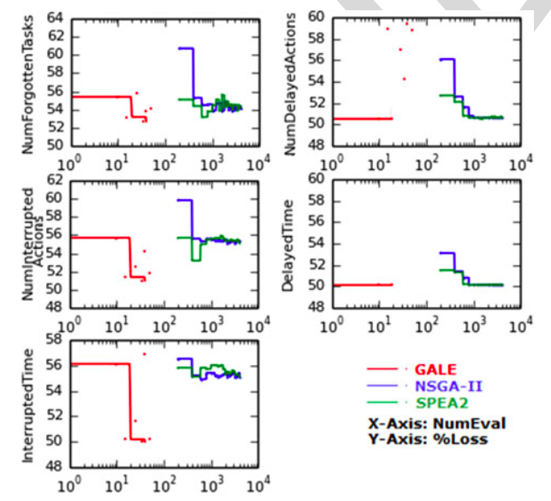
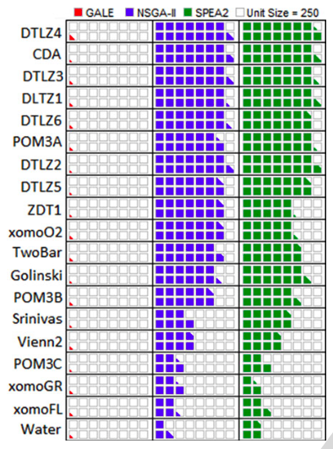
Works well, using far fewer evals
ai4se.net

Slide 30
Is WHERE a compression algorithm? Use it for the certification envelope? Ship models with a summary of their training data?
Anything lost for (e.g.) prediction?
Call each leaf one “class”
Run a decision tree learner to find a model for the “classes”
Vasil Papakroni, WVU masters thesis, 2012
Prediction using WHERE’s clusters works
Just as well as other standard methods
(for software effort and defect estimation)

Slide 31
Can WHERE support locality? Deliver specialized lessons for different problems?
Build one model per cluster using your learner de jour
O(log(N)) indexing of new data to old models
Push test data down the tree
Butcher, Menzies et al. Local vs Global. TSE’13. Local models have better medians and less variance

Slide 32
Is WHERE a tool for privacy?
Hide the individuals, preserves the shape of the data
Don’t share all the data, just the poles.
100% privacy on data not in poles
Don’t share the poles exactly,
Mutate them slightly, by no more than half the axis length
Predictions in reduced space work as well as in raw data space
Peters, Menzies, TSE’13, Balancing privacy and utility

Slide 33
Is WHERE an anomaly detector?
WHERE’s trees are a O(log(N)) time index to the leaves
Test data is “alien” if, after falling to its nearest leaf, it is outside of the poles
Peters, Menzies, ICSE’15, LACE2

Slide 34
WHERE and “the sharing trick”
Community of N data owners
Pass around a cache in random order
Owner “I” just adds anomalous data
Then privatized as per above
Cache size: < 5%
Models learned from cache as good or better than from all raw
Peters, Menzies, ICSE’15, LACE2

Slide 35
Is WHERE a pollution marking tool (here thar be dragons, best not go thar)
Mark in as polluted all sub-trees with more than X% anomalies
When making conclusions, stay away from the polluted sub-trees
Kocaguneli, Menzies et al, Analogy Estimation, TSE12

Slide 36
Is WHERE an incremental learner? (i.e. data mining for streams)
Build models per subtree, using your learner de jour
In all sub-trees, keep a sample of data plus any anomalies
When too many pollution markers, recluster just that sub-tree
Dianne Gordon-Spears (2002): such hierarchical incremental repair 10,000 times faster than global reorganizations

Slide 37
Executing
Published
To do
IEEE trans SE ’13b
IEEE trans SE ‘13a
Wvu ‘13
ESE ‘09 ESE ‘14
Icse ‘16?
ICSE ‘15
IEEE trans SE ‘12
IEEE trans SE ‘15

Slide 38
Lessons learned
What matters?
Certification envelopes (when not to trust conclusions)
Goals matter (not everything is “classification”)
Locality matters (when their conclusions do not hold for you)
Need “streaming tools” (continually stream over a never ending sequence of new data)
Need repair tools (to fix broken ideas)
Verification matters (sooner or later, we all screw up)
Need compression tools (to save space)
Need privacy tools (so you can share)

Slide 39
Software tools for “citizen scientists”.
Beyond mere data repositories
What happens when decision software goes wrong?
Proposed services for nextgen repositories
The Future?
ai4se.net

Slide 40
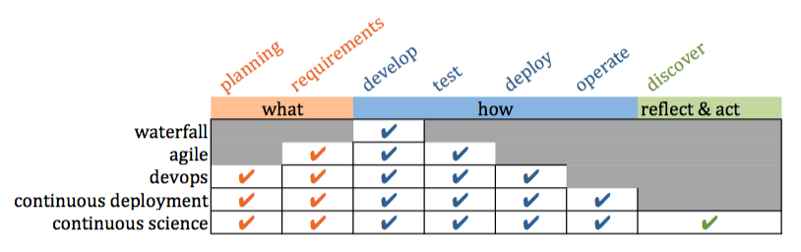
Confucius: “Study the past if you would define the future.”
History of SE
X is not part of SE
People are having trouble with X
Experiments: Extend SE to include X
Conclusion: “you know what? SE tool support makes X easier”

Slide 41
Confucius: “Study the past if you would define the future.”
Future of SE
Software mediates what we see and how we act in the world
Everyone with software is now a scientist
Software supports communities as they judge conclusions

Slide 42
To find the future, extrapolate the past
Future of SE
Software mediates how everyone sees and acts on the world
Everyone with software is now a scientist
Software supports communities as they judge conclusions

Slide 43
This talk
Services for data repositories supporting citizen scientists
Enabling reflect, act, discover
The next generation of continuous science.

Slide 44
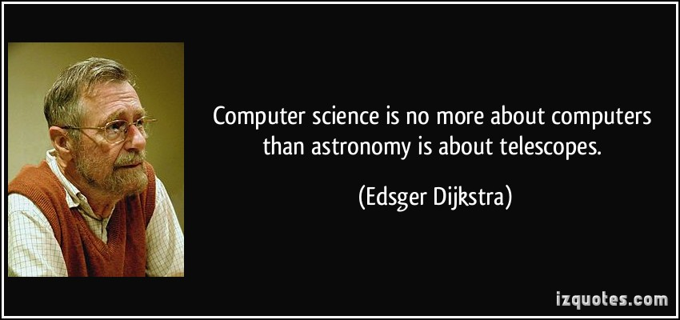
Software engineering researchers just studying software is like astronomers just studying telescopes.
After we grind the lenses, we should look through the scope.
After we build the software, we see how people are using it

Slide 45

End of my tale tail
Questions? Comments?

Slide 46
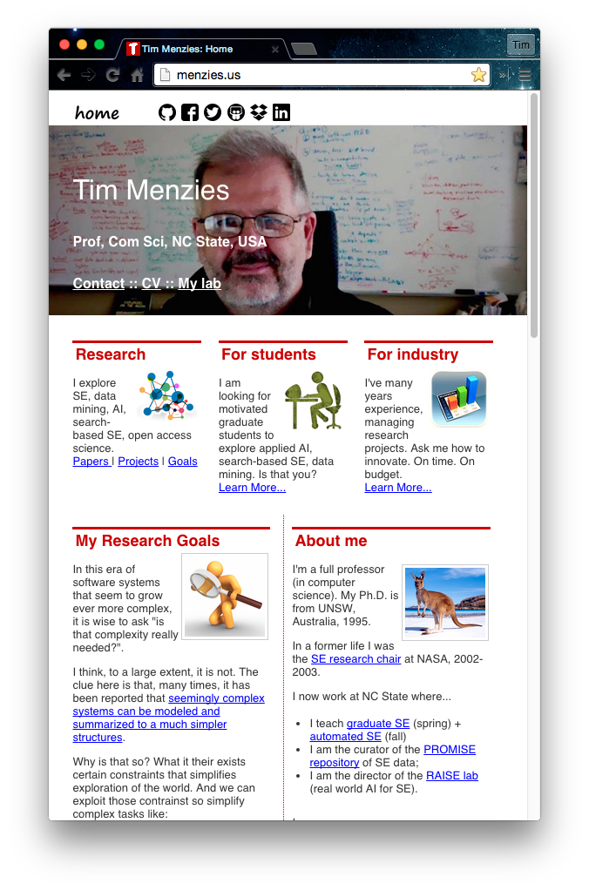
About me
Full Prof in CS NC State. Teaches SE and automated SE.
Researches synergies human+AI, with focus on data mining for SE.
Assoc editor IEEE Transactions on SE, Empirical SE, the Automated SE Journal , Software Quality Journal
Was co-PC-chair for ASE’12, ICSE'15 NIER track.
Will be co-general chair of ICMSE'16.
Author of 230+ referred pubs.
One of the 100th most cited authors in SE (of 80,000 http://goo.gl/BnFJs).
PI for NSF, NIJ, DoD, NASA, USDA, and research work with private companies.
Co-founder of the PROMISE conference series on reproducible experiments in SE.
Current curator PROMISE web site, SE research data http://openscience.us/repo .
Vita: http://goo.gl/8eNhYM
Pubs: https://goo.gl/qNQAIq
Home page: http://menzies.us

Slide 47
Backup slides

Slide 48
http://mshang.ca/syntree/
[clustering [contexts [locality [transfer]]]
[compression
[prediction [planning multi-goal optimization] ]
[privacy [sharing [verification]]]
[anomalyDetection certificationEnvelope
[pollutionMarking [incrementalRepair [streaming]]

Slide 49
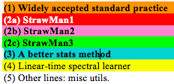
Code used in my last paper (1100 LOC of Python calling scikitlearn)

Slide 50
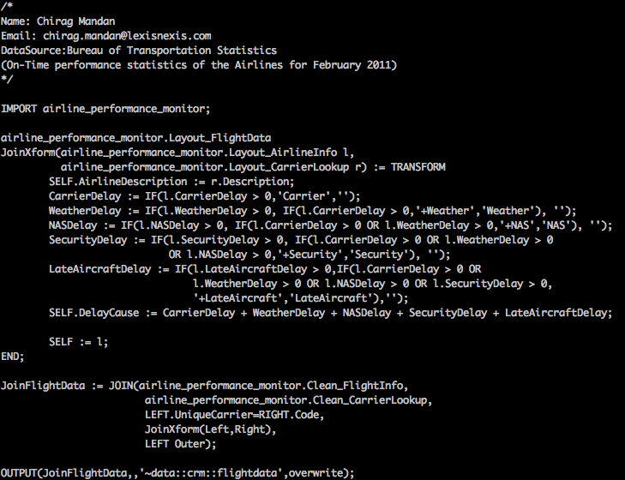
Note: not necessarily solved by higher-level languages
ECL: a higher-level set-based language (more succinct)
But if you can write it quick,
you can write it wrong, quick.
Implications for
markets, ambulances, government policies, homeland security, toasters. Air safety, Nobel prizes, web-company advertising polices, do we take the family to Cairo for a holiday, etc etc

Slide 51
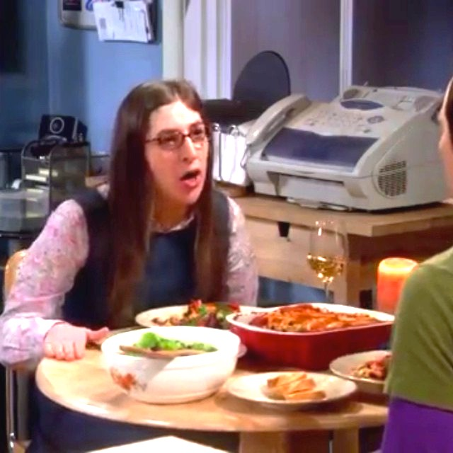
Recall the words of Dr. Amy Farrar Fowler, Ph.D.
Sheldon: a grand unified theory, insofar as it explains everything, will ipso facto explain neurobiology.
Amy: Yes, but if I’m successful….
I will be able to map and reproduce your thought processes in deriving a grand unified theory, and therefore, subsume your conclusions under my paradigm.
Apologies to fans of the BBT:
This conversation occurred in JPL,
cafeteria, not Amy’s flat
ai4se.net

Slide 52
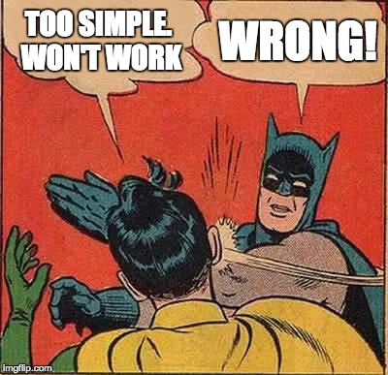

Slide 53
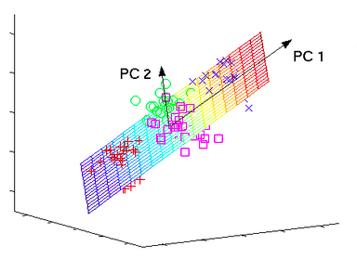
WHERE = fast analog for PCA (so WHERE is a heuristic spectral learner)
Spectral learners : works on eigenvectors
combine related influences
ignore outliers and irrelevancies
ai4se.net
53

Slide 54
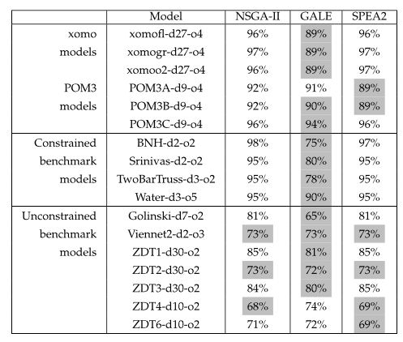
GALE: one of the best, far fewer evals
Gray: stats tests: as good as the best
ai4se.net

Slide 55
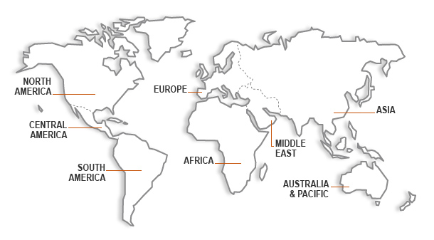

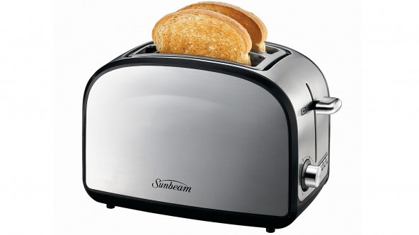
Transfer matters (and is possible)
When not enough local data, ask your friends
B.Turhan, T.Menzies, A. Bener, J. Di Stefano. 2009. On the relative value of cross-company and within-company data for defect prediction. Empirical Softw. Eng. 14(5) 2009,

Slide 56
Is WHERE a verification tool
With enough eyeballs,
Are all bugs are shallow?

Slide 57
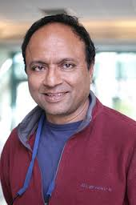
If it works, try to make it better
The PROMISE Project
“The following is my valiant attempt to capture the difference (between PROMISE and MSR)”
“To misquote George Box, I hope my model is more useful than it is wrong:
For the most part, the MSR community was mostly concerned with the initial collection of data sets from software projects.
Meanwhile, the PROMISE community emphasized the analysis of the data after it was collected.”
“The PROMISE people routinely posted all their data on a public repository
their new papers would re-analyze old data, in an attempt to improve that analysis.
In fact, I used to joke “PROMISE. Australian for repeatability” (apologies to the Fosters Brewing company). “
Dr. Prem Devanbu
UC Davis
General chair, MSR’14

Slide 58
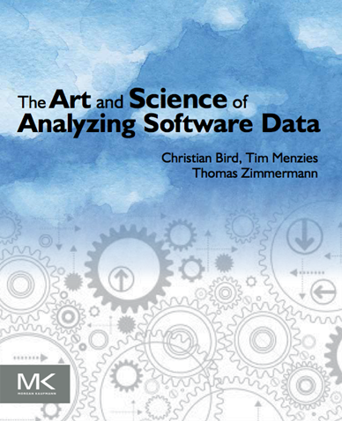

The PROMISE Project
Our summary. And other related books
The MSR
community
and others
Perspective on Data Science for Software Engineering
Tim Menzies
Laurie Williams
Thomas Zimmermann
2014
2015
2016

